Slide 1





GENERAL LEDGER
OPERATIONS AND FINANCIAL REPORTING IN ORACLE ERP OBJECTIVES
MAY 2025
SPONSORED BY

Slide 2





OUR TEAM
Our team is a diverse blend of finance experts, technology specialists, and strategic thinkers committed to elevating your organization’s financial operations through Oracle ERP. With a passion for innovation and a collective dedication to excellence, we bring deep industry expertise and fresh perspectives to every phase of the General Ledger implementation.
Ashrakat Mahmoud
Nada Zidan
Asmaa Monir
Hager Khairy
Sara Khairy

Slide 3

CONTENT
01
Overview
02
Creating User And Responsibility
03
Calendar
04
Currency
05
Chart of Accounts (COA)
06
Journals
06
Reports

Slide 4
OVERVIEW
Founded in 1977 by Larry Ellison, Bob Miner, and Ed Oates in Austin, Texas, Oracle is a global leader in technology, software, and cloud services. The company is best known for its Oracle Database, one of the most powerful database systems in the world, and for offering cloud solutions through Oracle Cloud Infrastructure (OCI). Oracle also provides a wide range of enterprise software, including ERP, CRM, and other business applications, serving businesses of all sizes with innovative and reliable technology.
01
What Oracle Does
Oracle is renowned for its powerful Oracle Database, one of the leading database systems globally, and for providing cloud-based solutions through Oracle Cloud Infrastructure (OCI)
02
Why Oracle Matters
Oracle is recognized for its innovation, scalable solutions for businesses of all sizes, and reliable, high-performance systems trusted by leading global companies.
03
Mission of Oracle
To help businesses transform and innovate by providing integrated, scalable, and secure technology solutions.

Slide 5

CREATING USER AND RESPOSIBILITY

Slide 6
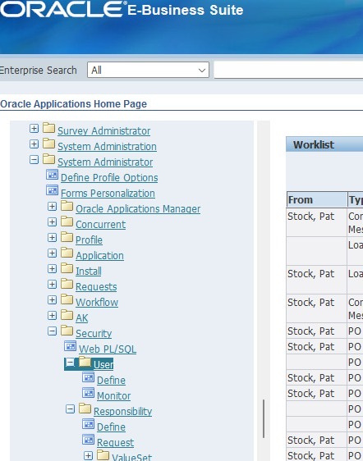
Steps of creating user:
Navigation Responsibility:
System Administrator
Security
User
Definition

Slide 7
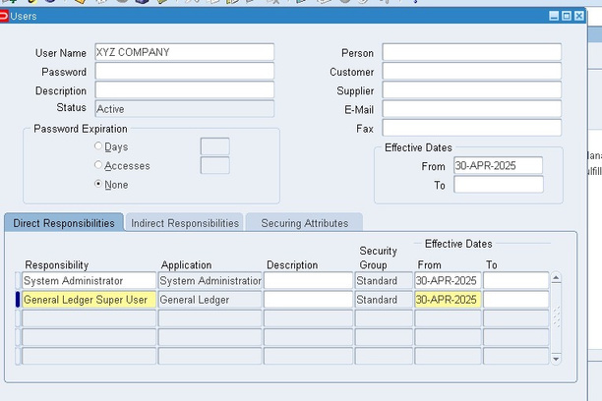
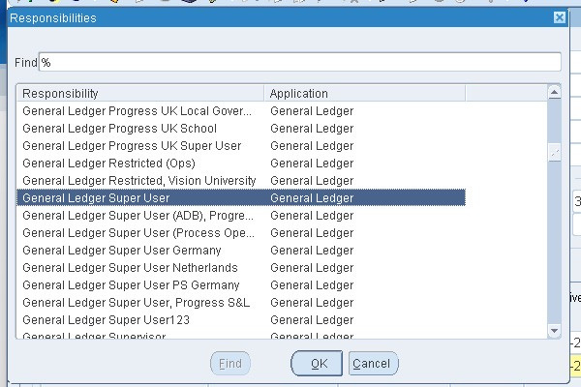
Steps of creating user:
Input your Username
Re-enter your Password
Specify the Effective Date From
Choose the Required Responsibilities
Click on Save & Close

Slide 8
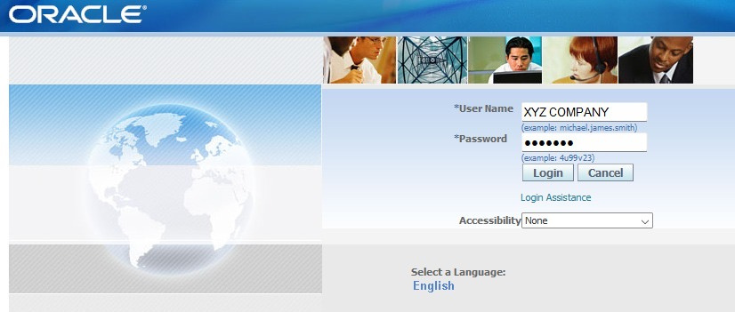
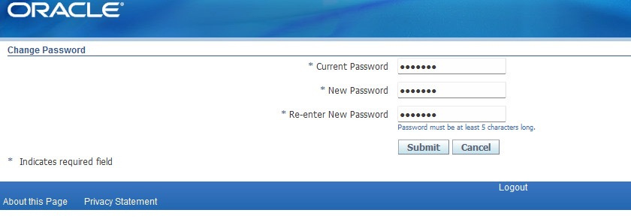
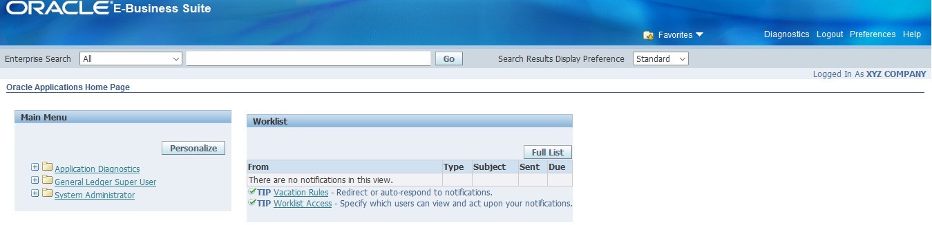
Steps of creating user:
Registration for a New User
During registration, a password change page appears.
The user is prompted to enter their old password.
The user is also required to enter the new password twice for confirmation.
After completing this step:
A new user is successfully created.
Their roles and responsibilities are assigned.
The system enables login using the new username.
.

Slide 9
CALENDAR
A Calendar in Oracle defines how financial periods are structured and used for recording transactions.

Slide 10


TYPES OF CALENDARS:
Calendar Year
Fiscal Year
Starts from Jan 1 to Dec 31.
Standard 12 months
Starts and ends on custom dates (e.g., July–June, April–March).
Still usually 12 months, but aligned with the company’s financial reporting cycle.

Slide 11
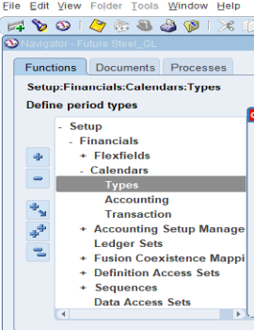
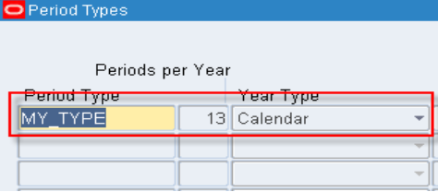
Step to Set Up a Calendar :
Path:
Set Up → Financial → Calendar → Type
1.Enter the Period Type Name:
In the Period Type field, enter a name for your calendar period (e.g., XYZ company).
2. Set the Number of Periods per Year
In the Periods per Year field, enter the number of periods (e.g., 13 if you include an adjustment period).
3. Define the Year Type:
Calendar → for standard January to December years.
Fiscal → for custom fiscal year start/end dates.

Slide 12
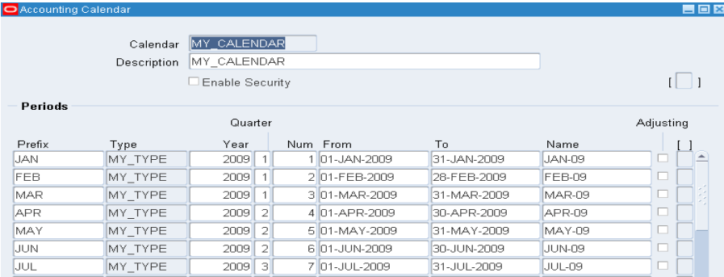
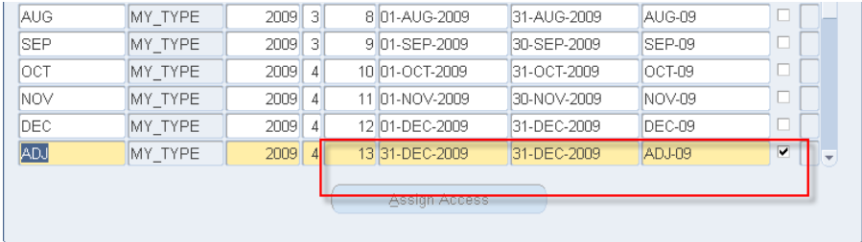
Steps to Define a Fiscal Calendar :
Path:
Set Up → Financials → Calendars → Fiscal
1.Enter Calendar Information:
Enter a name & description for your fiscal calendar in the Calendar Name & description fields.
Set the Period Type to the one you created earlier (e.g.XYZ Company).
2. Define Period Details
Enter the Period Month, Year, Start Date, End Date, and Quarter Number for each period.
Enter the Number of Periods (typically 13 if you include an adjustment period).
Mark the adjustment period as Enabled so it can be used for year-end adjustments and correcting entries.

Slide 13
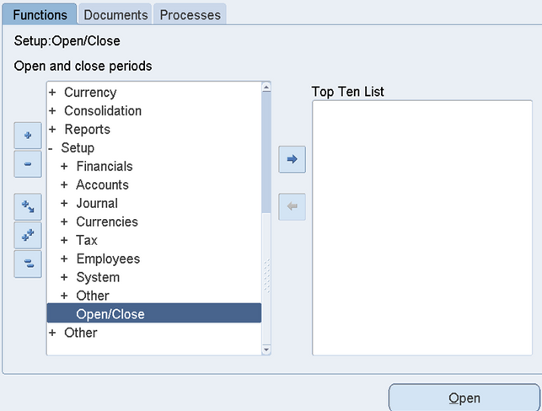
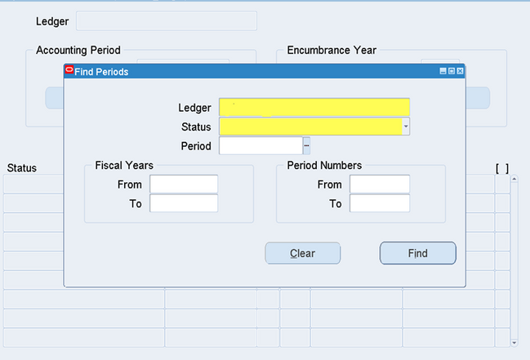
Steps of Opening and Closing Periods
Path:
Set Up → Open/Close
1. Access the Find Periods Screen:
Navigate to the "Find Periods" screen.
Ensure the Ledger field displays the name of your company's ledger.
2. Status Field Options:
Open: Period is open for posting transactions.
Closed: Period is closed; no further transactions allowed.
Future: Period is upcoming and not yet available for posting.
Permanently Closed: Period is permanently closed; no changes
can be made.
3. Periods:
The screen will display all periods created in the ledger’s calendar.
4. Period Numbers:
Period numbers refer to the sequence of accounting periods
(e.g., Period 1 for January, Period 2 for February).
Helps organize and reference periods easily.

Slide 14
CURRENCY
It is used in financial transactions within databases or applications
related to Oracle ERP or Oracle Financials.

Slide 15
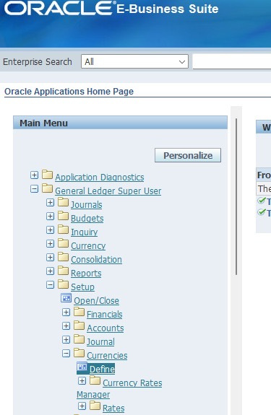
Steps to create a currency:
1. Navigate to the Define Currencies Window:
Path:
Setup
Currencies
Define

Slide 16
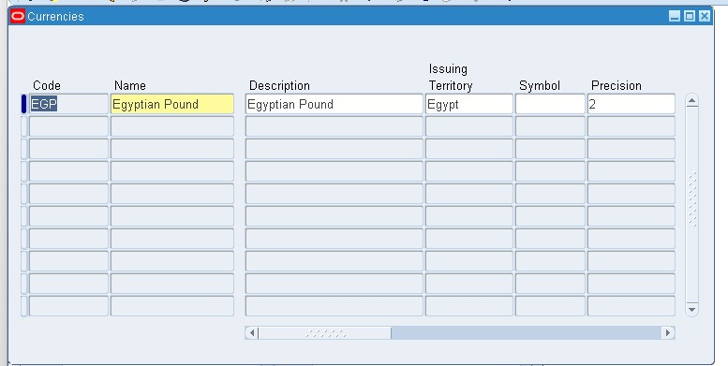
Steps of creating user (Cont.)
2. Enter Currency Code:
Input a unique Currency Code (e.g., USD, EUR, EGP).
3. Enter Currency Name and Description:
Provide a meaningful Name (e.g., US Dollar) and Description.
4. Set Precision and Symbols:
Define precision (e.g., 2 decimal places).
Enter symbol (e.g., $ or E£).
5. Set Date Ranges (if required):
Specify the start and end dates for the currency validity (optional).
6. Save the Record:
Click Save to store the new currency.

Slide 17
CHARTS OF ACCOUNTS (COA)
The Chart of Accounts (COA) is a structured list of all the accounts used by an organization to record its financial transactions. It serves as the foundation for the accounting system and helps categorize all financial activities into assets, liabilities, equity, revenues, and expenses.

Slide 18


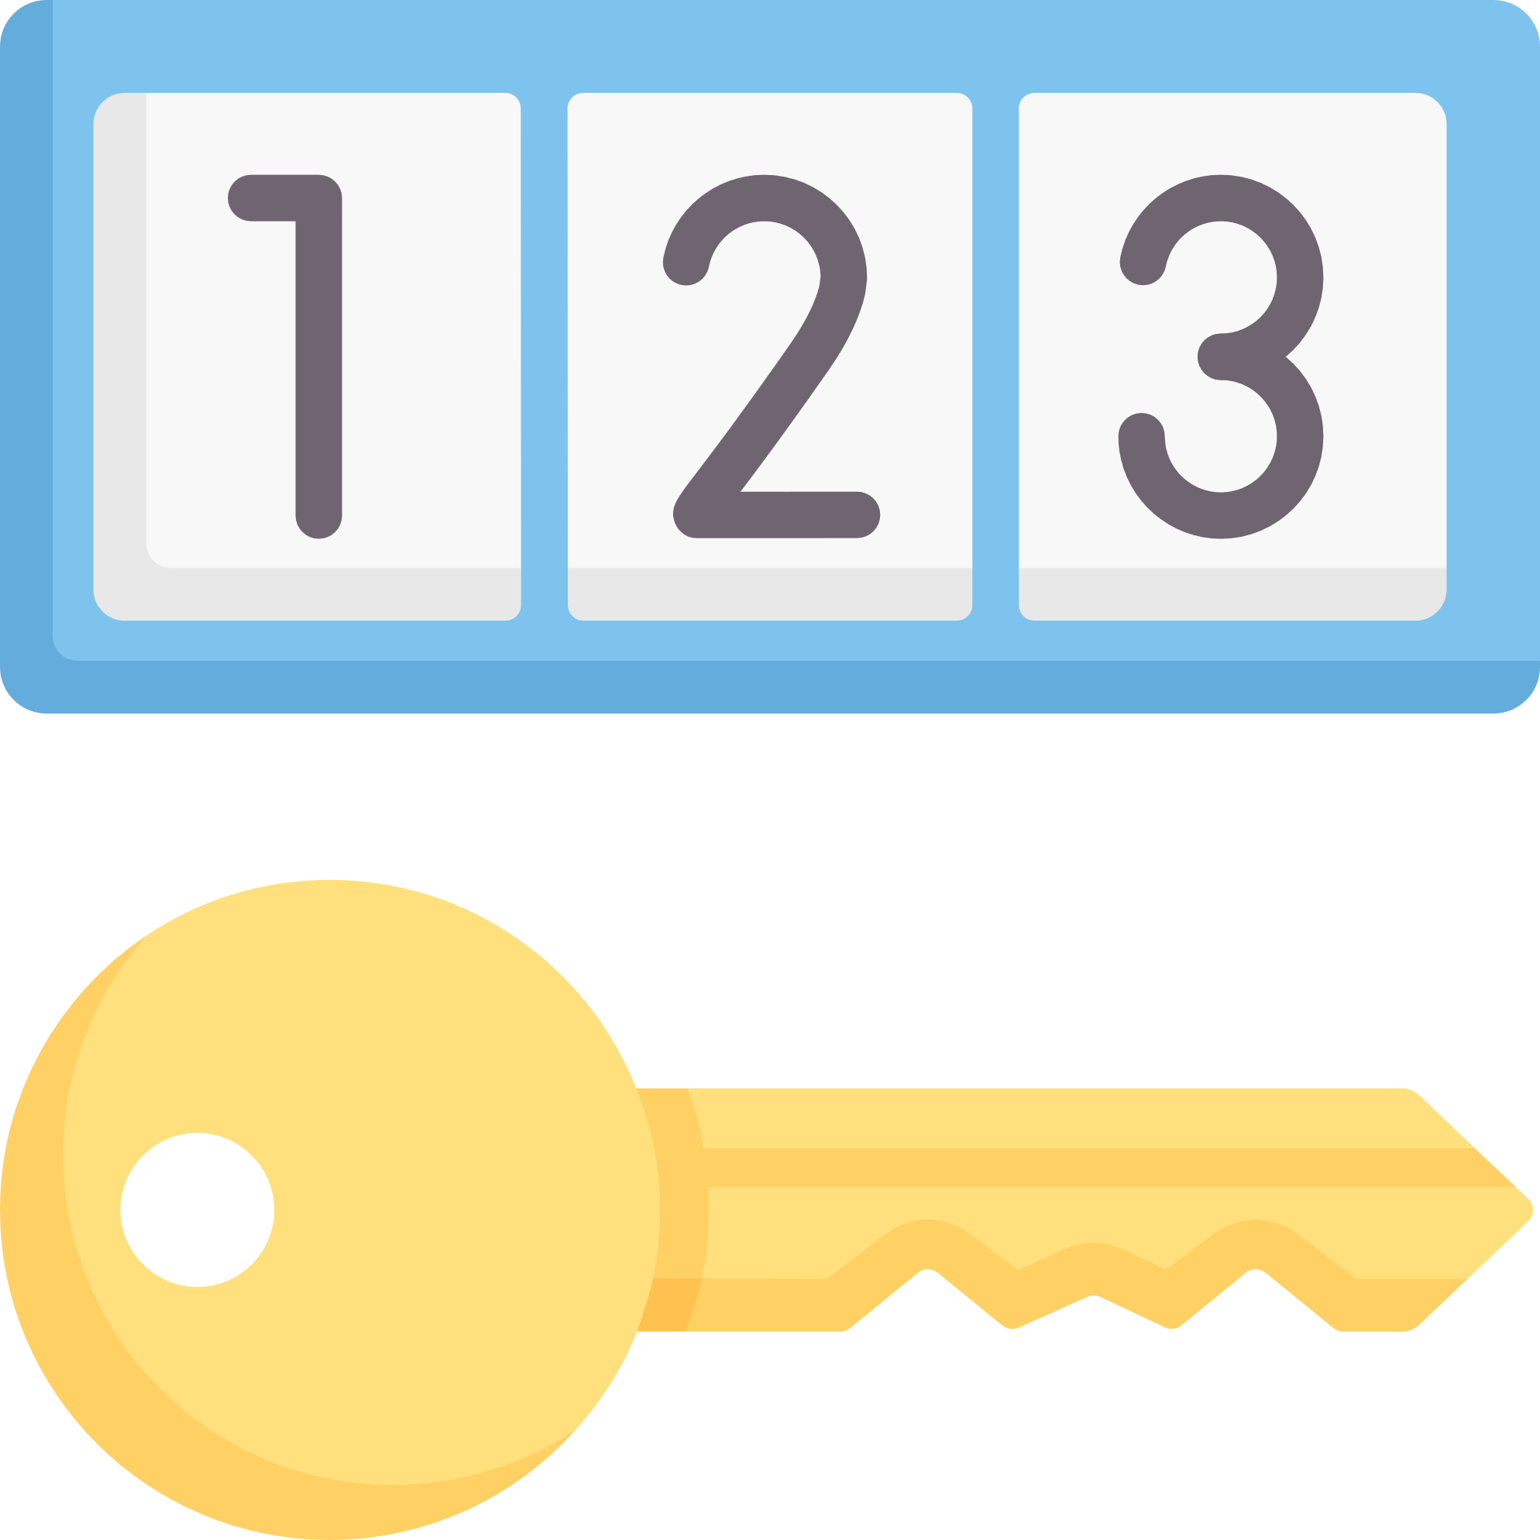
COMPONENTS OF COA
Structure
Values Set
Code combination
It defines the order and meaning of each part in the account code, Each part is called a segment (like company, account, etc.)
A value set is a list of allowed values for each segment
A Code Combination is the full account code made by joining values from all segments
It is created by choosing one value from each segment.

Slide 19
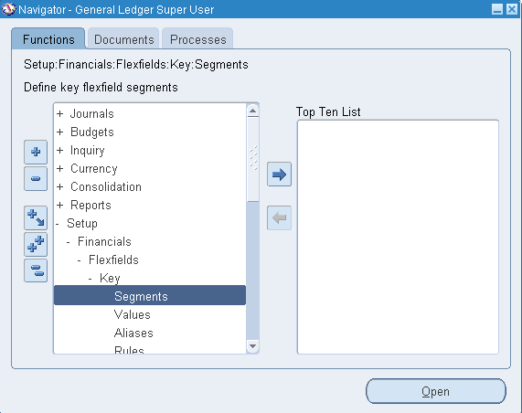

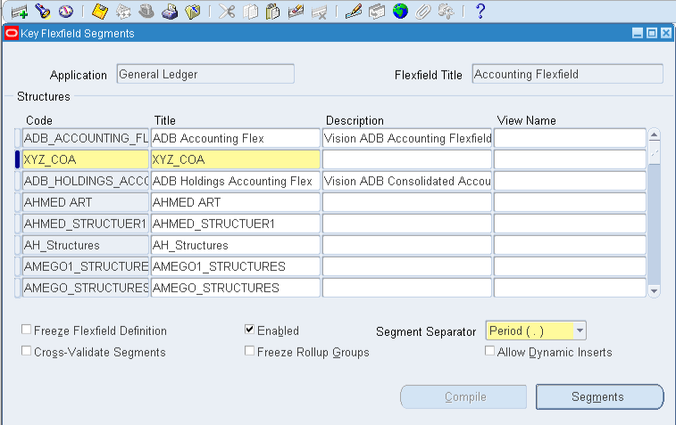

Steps of COA Set Up
1. Identify Structure Segments:
Path:
Set Up → Financial → Flexfields → Key → Segment.
Navigate to the "Key flexfields Segments" screen.
For the Application choose General Ledger and Accounting Flexfield for the flexfield title.
Add your Structure, name it, and then Click Segments to Start identifying your segments.

Slide 20
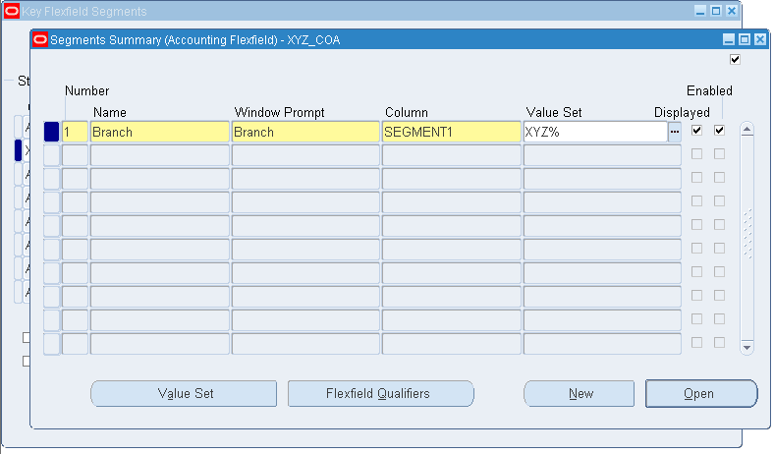
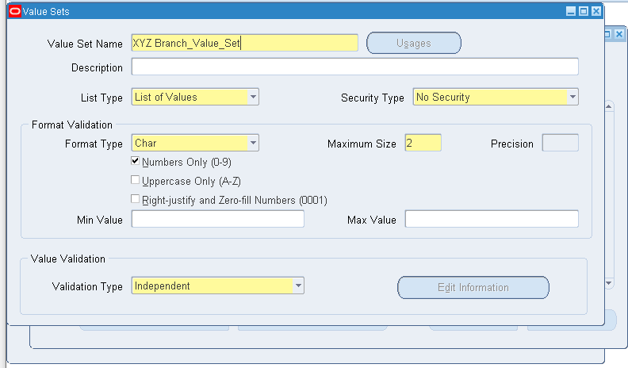
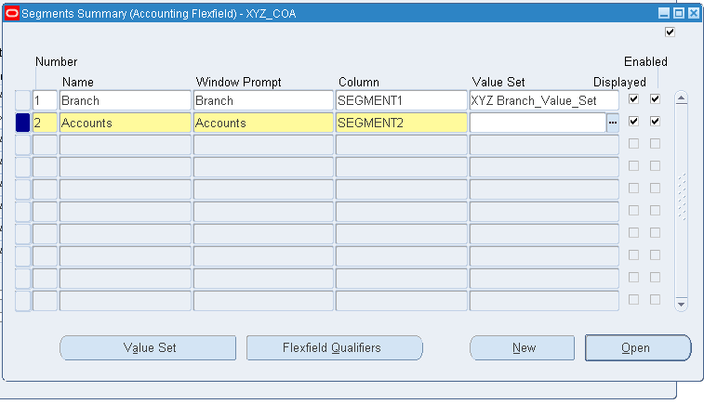
Steps of COA Set Up
1. Identify Structure Segments:
Navigate to “ Segments Summary” Screen.
Add your first segment
Click the Value Set Putton in the to create the segment related value set.
Add this Value set to your segment.
Repeat the same steps for accounts and cost Center Segments.

Slide 21
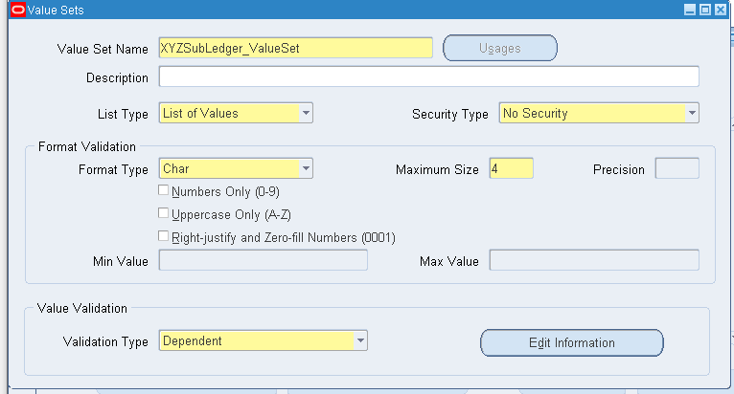
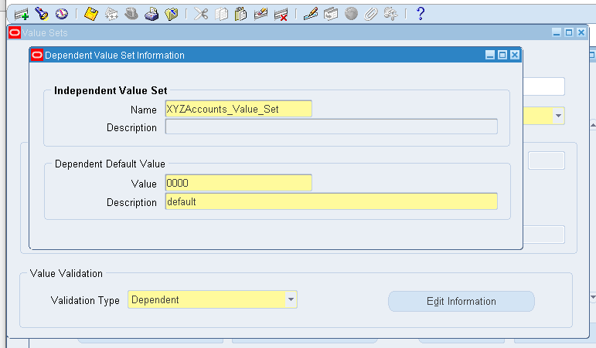

Steps of COA Set Up
1. Identify Structure Segments:
Sub accounts Value set have a different nature as it is a dependent Value set
Navigation:
Select dependent when creating the value set then click “Edit information”.
Add the independent value set and the default value.

Slide 22
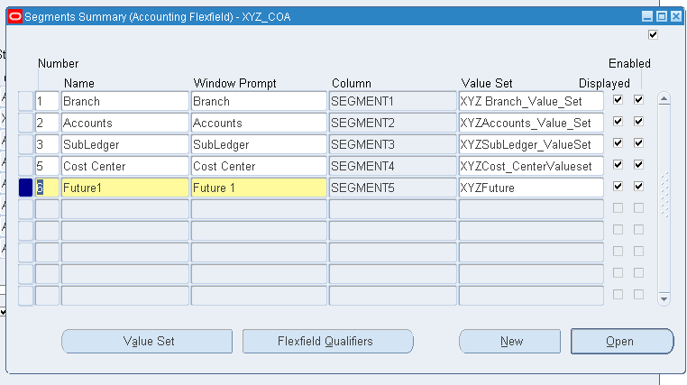

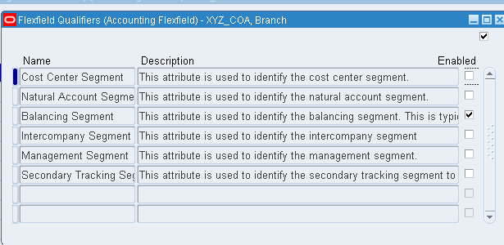
Steps of COA Set Up
1. Identify Structure Segments:
Add “ future segment “ as it allows easy expansion later without changing the whole structure.
Click “ Flexfield Qualifier “ to Identify the role of each segment in the accounting process.
Select the check box for :
- Branch as the balancing segmant.
- Accounts as Natural Accounts Segment.
- Cost Center as Cost Center

Slide 23
Steps of COA Set Up
What is a Flexfield Qualifier?
Flexfield qualifiers are labels we assign to each segment in the COA structure, They tell Oracle the role of each segment in the accounting process, You must assign one qualifier to each key segments
Main types of qualifiers:
Natural Account: Holds the type of account (asset, expense, revenue, etc.).
Balancing Segment: Used to balance accounting entries (usually the company segment).
Cost Center: Identifies departments or responsibility areas.
Intercompany: Used for intercompany transactions.

Slide 24
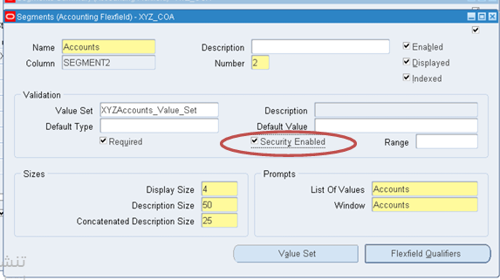
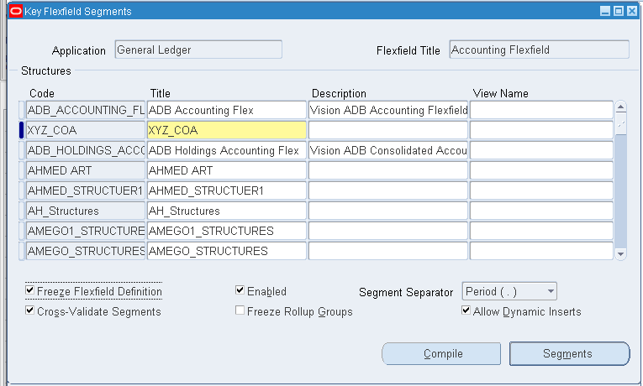

Steps of COA Set Up
open each Segment and mark the Security enabled check box.
Click Save then go back to “Key Flexfield Segment” and mark the freeze flexfield, then click Compile.

Slide 25
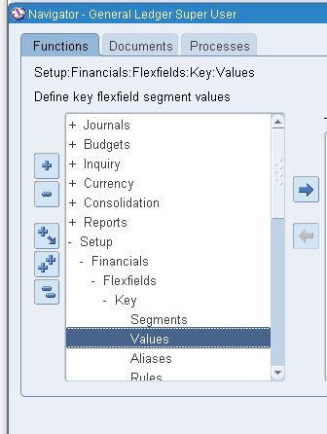
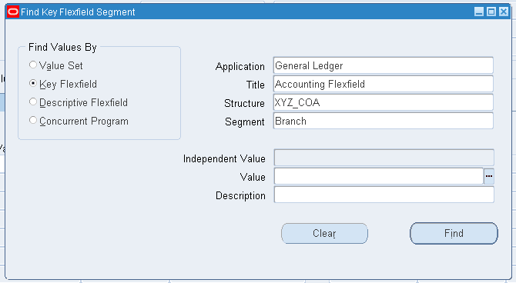
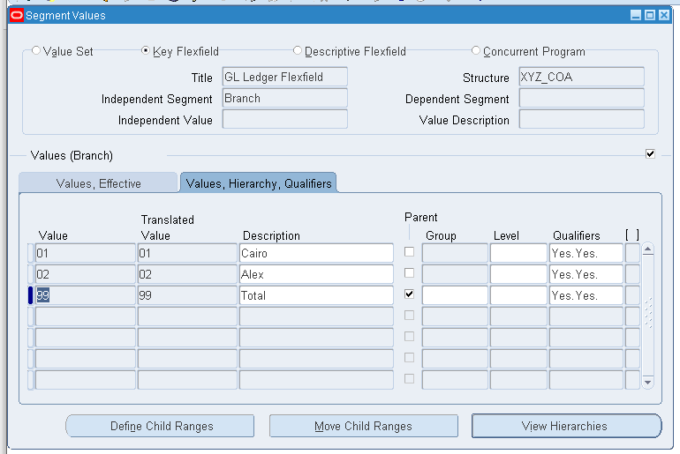

Steps of COA Set Up
2. Add Values to each Segment:
Path:
Set Up → Financial → Flexfields → Key → Values.
Choose the Application as General Ledger, the title as Accounting Flexfield, select the Created structure then identify each segment.
Click Find to add the Values.
Enter the values and description
Select Yes in the Qualifier section for “allow Post and allow budget”.
Click define Child Ranges.

Slide 26
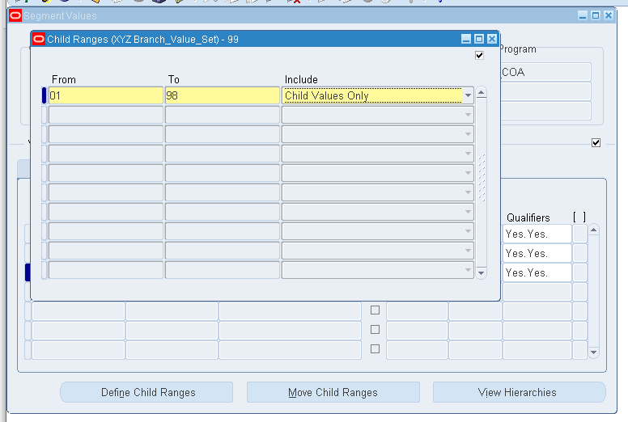
Steps of COA Set Up
2. Add Values to each Segment:
Define the child values under the selected Parent using a range
Save your work
NOTES :
Parent values are used for grouping and reporting and cannot be used directly in transactions.
Child values are detailed and transactions usable values.

Slide 27

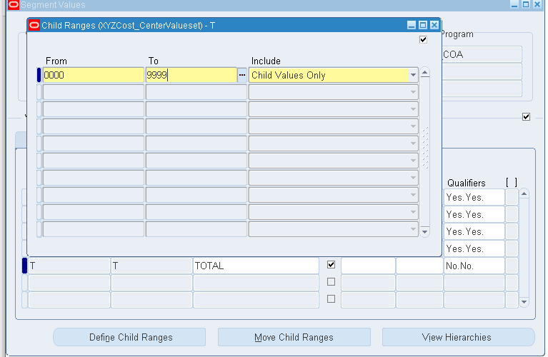
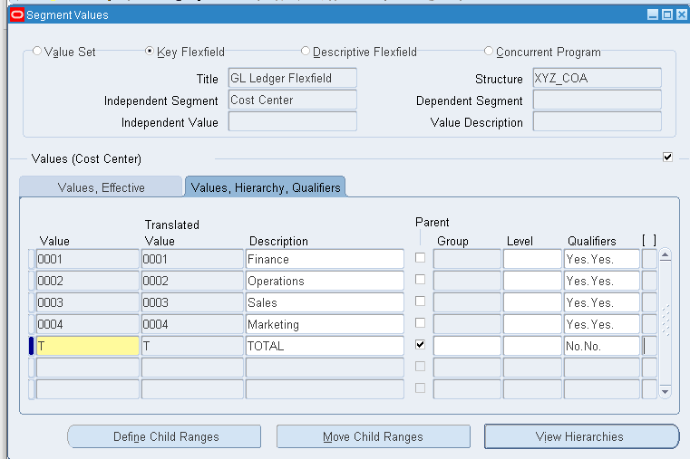
Steps of COA Set Up
2. Add Values to each Segment:
Save your work and Repeat the same steps with the Cost Center segment.

Slide 28
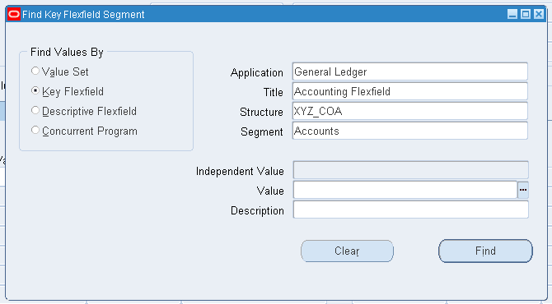
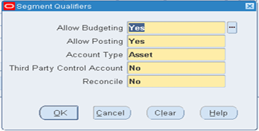
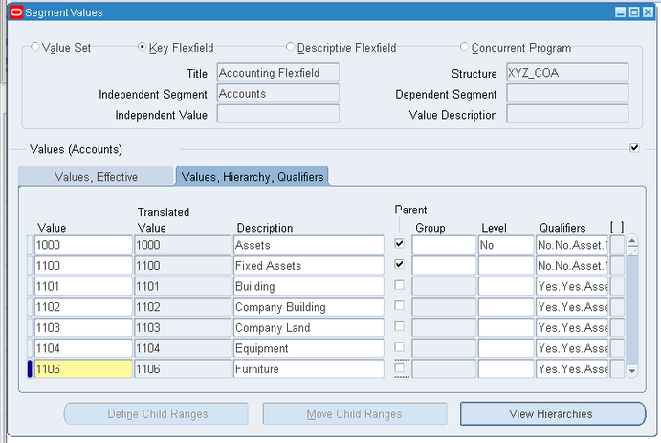
Steps of COA Set Up
2. Add Values to each Segment:
Save your work and Repeat the same steps with the Accounts Segment.
Identify the type of each account ( Asset, Liability, expense, etc ) From the Qualifiers
Define the Child Range for each Parent Account

Slide 29
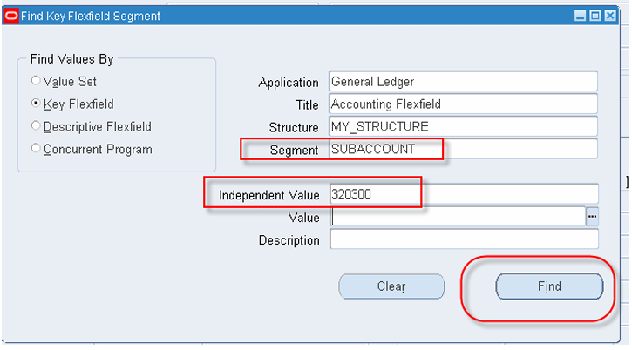
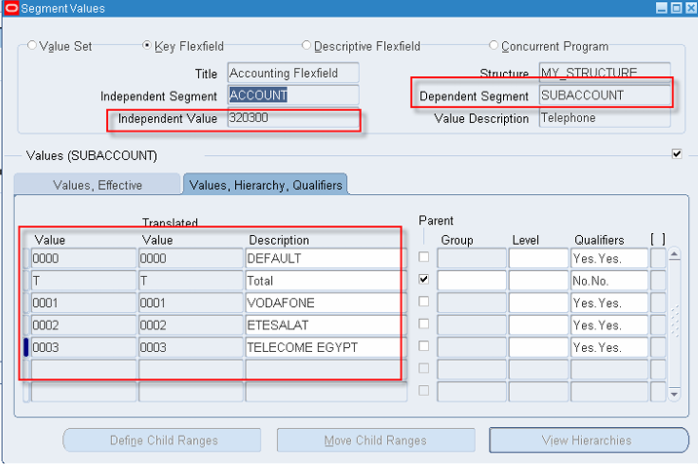
Steps of COA Set Up
2. Add Values to each Segment:
Save your work and go back to Enter the Sub Accounts Values
Enter the independent Account and Click Find.
Repeat the same steps.

Slide 30
JOURNALS
Journals are used to track all financial activities, such as sales, purchases, or adjustments, before they are posted to the general ledger. Specialized journals (e.g., sales journal, cash receipts journal) may also be used for high-volume transactions to streamline recording.

Slide 31



TYPES OF JOURNALS
Standard Journal
Reversing Journal
Recurring Journal
A journal entry that is automatically or manually reversed in a future period.
Used to correct accruals and temporary adjustments.
Types of Reversals:
Switch Dr/Cr.
Change Sign.
A journal created once and repeated periodically that can be used for regular, consistent transactions like depreciation, rent, and payroll allocations.
Types of Recurring Journals:
Skeleton
Formula
Standard
Used for recording regular, day-to-day financial transactions.
Includes both manual and system-generated entries like expenses, revenue, and adjustments.

Slide 32
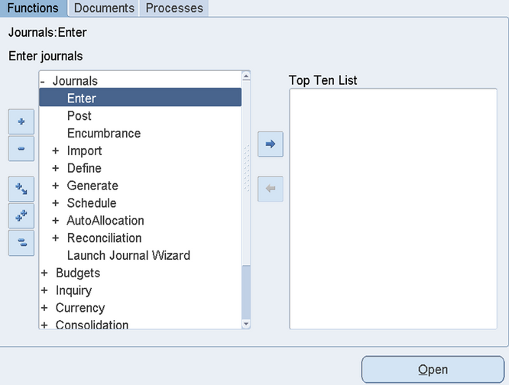
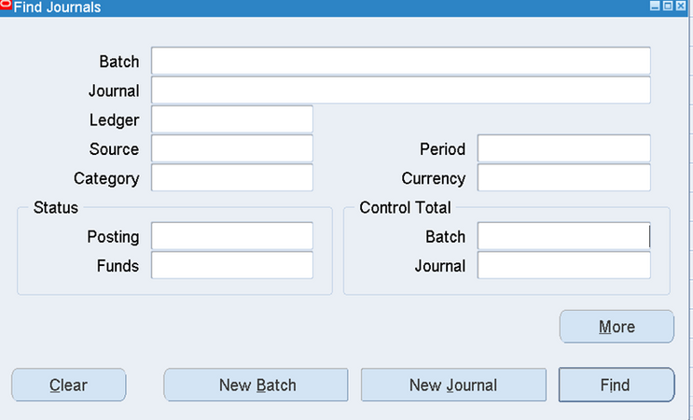
Steps of Entering ٍStandard Journal
Path:
General Ledger (Responsibility) - Journal - Enter - New Journal
The "Find Journal" screen will appear.
Functions in Find Journal Screen:
Batch: Groups related journals within a specific period.
Journal: Shows individual journal entries in a batch.
Ledger: Tracks and totals financial transactions.
Source: Identifies the origin of the transaction (e.g., department).
Category: Classifies transactions for organization and reporting.
Period: Specifies the accounting period of the transactions.
Currency: Displays the transaction currency.
Posting: Indicates if entries are posted to the ledger.
Funds: Reflects the availability/status of transaction funds.
.

Slide 33
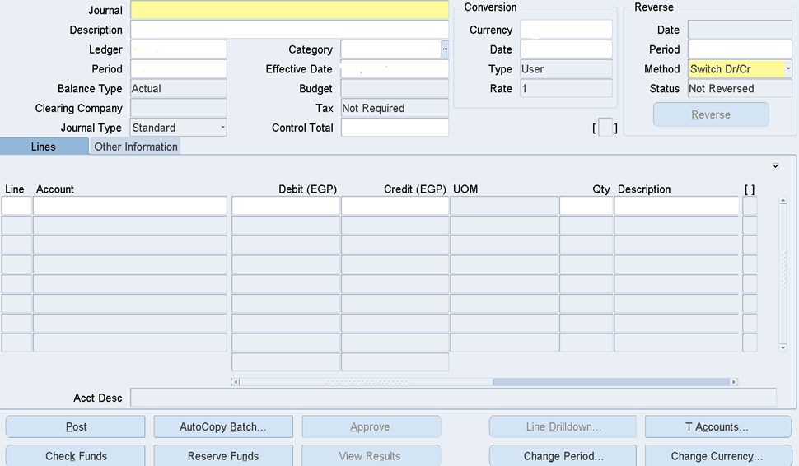
Steps of Entering Basic Journal (Cont.)
Header Section (Journal Details)
Journal: Name/ID of the journal entry (required)
Description: Brief reference for the journal entry
Ledger: Specifies the ledger for posting
Period: Accounting period of the entry
Balance Type: Indicates Actual, Budget, or Encumbrance
Clearing Company: Used for intercompany transactions
Journal Type: Defines type (Standard, Reversal, Adjusting)
Conversion Section (Foreign Currency Transactions)
Currency: Currency used in the journal
Date: Date for currency conversion
Type: Source of rate (User, Corporate, Spot)
Rate: Exchange rate applied
Reversal Section (Journal Reversal Settings)
Date: Reversal date (if applicable)
Period: Reversal accounting period
Methods : Switch Dr/Cr or Change Sign
Status: Shows if journal is reversed
Reverse Button: Executes the reversal

Slide 34
Steps of Entering Basic Journal (Cont.)
Category Section
Effective Date: Date the category becomes active
Budget: Indicates relation to budget entries
Tax Control Total: Total amount for tax control
Not Required: Flags non-mandatory fields
Line Account Section
Debit (EGP): Debit amount in Egyptian Pounds
Credit (EGP) UOM: Credit amount with unit of measure
City Description: Location-related description
Account Description Section (Action Buttons)
Post: Post the journal entry
AutoCopy Batch: Duplicate a batch of entries
Approve: Approve the journal
Line Drilldown: View line-level details
T Account: Access T-account view

Slide 35
TYPES OF RECURRING JOURNAL
Skeleton Recurring Journal
keeps the same accounts each period, but the user manually updates the amounts as needed. It's useful for variable monthly allocations like office expenses.
In Oracle ERP (Enterprise Resource Planning), Recurring Journals are used to automate the entry of journal transactions that are repeated periodically. These journals help reduce manual data entry and ensure accuracy in financial reporting.
Standard Recurring Journal
used when both the accounts and amounts remain consistent each period. It's ideal for fixed transactions like rent, depreciation, or loan payments, with the system automatically posting the same values every time.
Formula Recurring Journal
used when amounts are calculated dynamically using predefined formulas. It's ideal for allocations like employee benefits based on salary percentages or revenue accruals from sales. Formulas can reference actual, budget, or statistical balances.

Slide 36
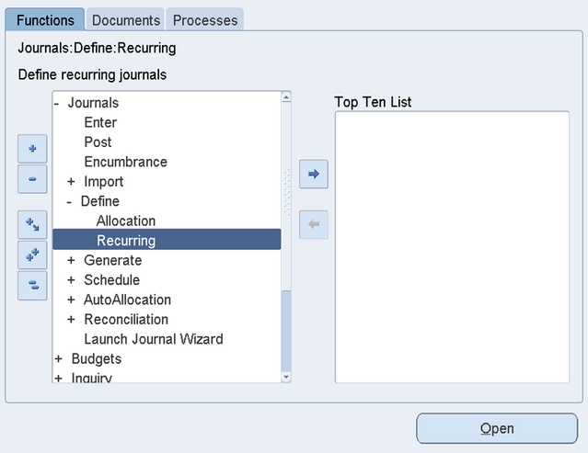
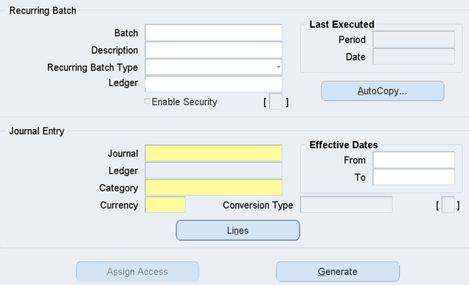
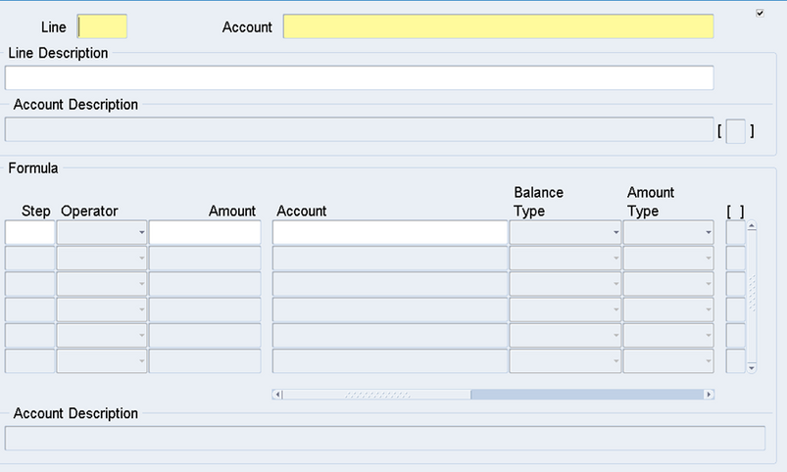
Steps of Entering Standard Recurring Journal
1.Navigate to:
Journal → Define → Recurring
2. Enter Header Information:
Fill in all required fields for the batch or journal.
Click Lines to proceed.
3. Enter Journal Lines:
Add the lines and specify the accounts you
want to use.
Click Save after entering the details.
4. Return to Previous Screen:
Click Generate to create the recurring entry.
6. Submit the Journal:
Enter the submit date and select the period for which the journal should be generated.

Slide 37
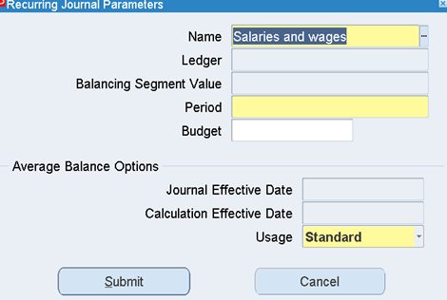
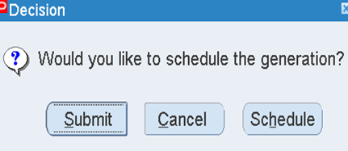
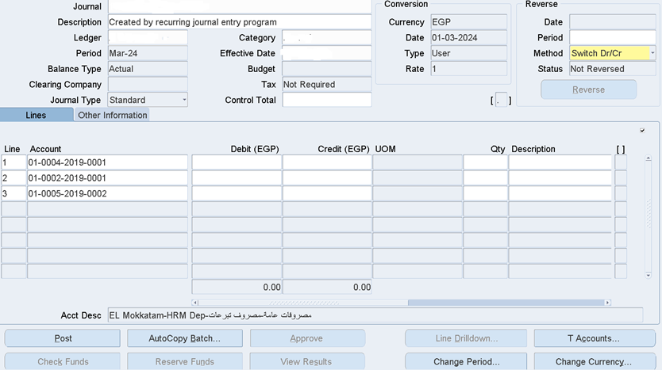
Steps of Entering Standard Recurring Journal (Cont.)
Note:
The journal will be created in the selected period without any debit or credit balances (amounts can be added manually or through updates).

Slide 38
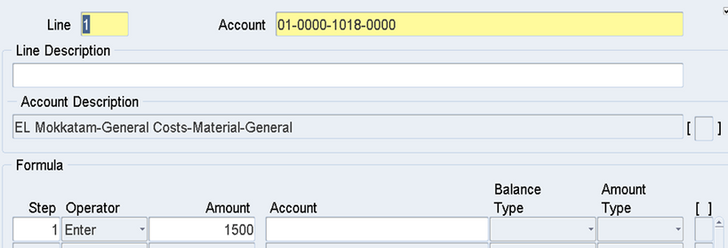
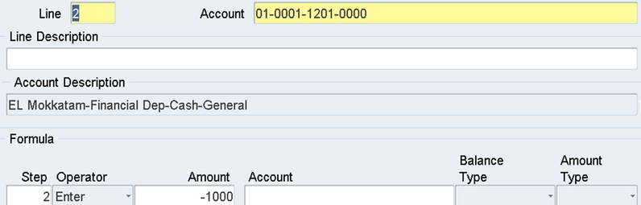
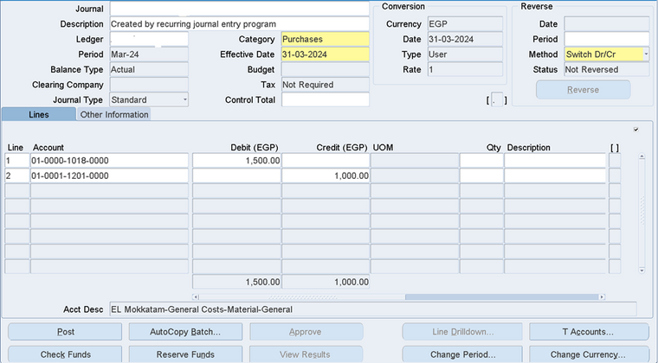
Steps of Entering Skeleton Recurring Journal
1. Enter Header Information:
Fill in the required fields to define the recurring journal batch or journal.
Click Lines to proceed.
2. Define Journal Lines:
Enter the account combinations for debit and credit entries.
Use a positive sign for debit and a negative sign for credit.
Do not enter amounts at this stage, as they will change each period.
3. Click Save:
Save the journal with fixed account lines.
4. Generate and Submit Each Period:
Navigate to Generate, then enter the period and manually input the amounts for that specific period.

Slide 39
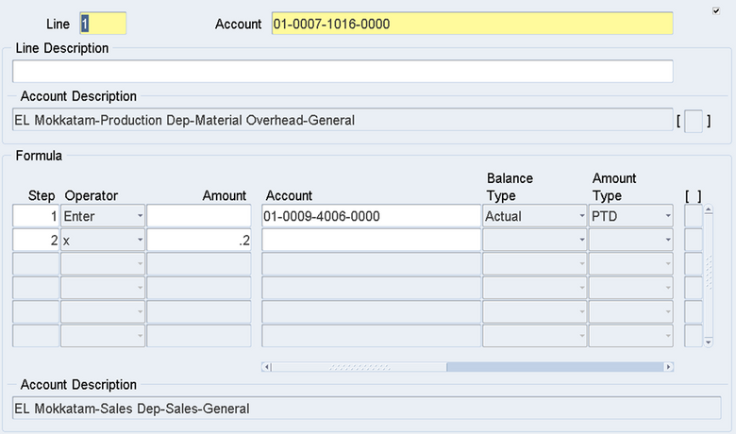

Steps of Entering Formula Recurring Journal
1. Defining Debit and Credit Accounts:
o Specify the account(s) where the calculated amounts will be posted.
o Example: 01-0007-1016-0000 for Material Overhead allocation.
2. Enter a Formula Instead of a Fixed Amount:
o Click in the Amount field.
o Input a formula using Oracle’s calculation features.
o Formulas can reference:
Actual balances (e.g., Period-to-Date amounts from a specific account)
Budgeted amounts (e.g., departmental budget allocations)
Statistical data (e.g., employee count, machine hours)
3. Example Formula Logic:
o Step 1: Pull the Actual PTD balance from account 01-0009-4006-0000.
o Step 2: Multiply the retrieved amount by 0.2 (20%).
o Result: 20% of this balance is allocated to account 01-0007-1016-0000.
4. Save and Generate:
o Save the journal.
o Return to the previous screen and click Generate.
o Submit the journal for the desired period.

Slide 40
REPORTS

Slide 41
Steps to Generate GL Reports:
Accessing the GL Reporting Module
Log in to Oracle Applications with GL responsibility
Navigate to:
General Ledger
Reports
Report
2. Standard GL Report Types Oracle provides several built-in GL reports:
Trial Balance Reports
Journal Reports
Account Analysis Reports
Period Close Reports
Consolidation Reports
Budget Reports

Slide 42
ٍSteps Running a Trial Balance Report (Example)
Step 1: Navigate to Report Request
1. Go to: General Ledger > Reports > Financial > Trial Balance
2. Click "Submit New Request"
Step 2: Set Parameters
1. Accounting Period: Select desired period
2. Currency: Choose functional or foreign currency
3. Balance Type: Actual, Budget, or Encumbrance
4. Format Options:
- Detail or Summary level
- Show zero-balance accounts (Y/N)
- Show budget variances (Y/N)
Step 3: Account Selection
1. Specify account ranges:
- From Account: [Starting account]
- To Account: [Ending account]
2. Optionally select by:
- Cost Center
- Product Line
- Other segment values
Step 4: Output Options
1. Choose output format:
- PDF (default)
- Excel
- HTML
2. Set notification preferences

Slide 43

Steps of Creating FSC Reports:
Step 1: Define Report Components
1. Path: General Ledger > Setup > Financials > FSG
2. Set up in this order:
- Row Sets : define account groupings
- Column Sets : define period comparisons
- Content Sets : optional formatting
- Report Sets : combine multiple reports
Step 2: Build a Custom Report
1. Path : General Ledger > Reports > Financial > Define
2. Click "Create New Report"
3. Assign row and column sets
4. Set display options :
- Page breaks
- Calculations
- Override descriptions
Step 3: Save and Assign Access
1. Save with meaningful name
2. Assign to appropriate responsibility

Slide 44



Steps of Creating FSC Reports (cont.):
Row Sets :
Column Sets :

Slide 45
Extra Points
Scheduling Reports
Exporting GL Data to Excel
1. Run any standard GL report
2. Choose Excel as output format
Alternative method:
Use : General Ledger > Inquiry > Account Inquiry
Query desired data
Click "Export to Spreadsheet"
1. Navigate to: General Ledger > Reports > Financial
2. Select desired report
3. Choose "Schedule" instead of "Submit"
4. Set recurrence pattern:
- Daily
- Weekly
- Monthly
- End of period

Slide 46

THANK YOU
FOR YOUR ATTENTION
MAY 2025

